Slide 1
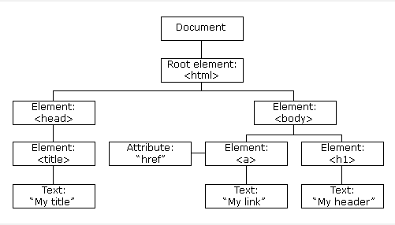
DOM
When a web page is loaded, the browser creates a Document Object Model of the page.
The HTML DOM model is constructed as a tree of Objects

Slide 2
Document structure
You can imagine an HTML document as a nested set of boxes.
Tags such as <body> and </body> enclose other tags, which in turn contain other tags or text.

Slide 3
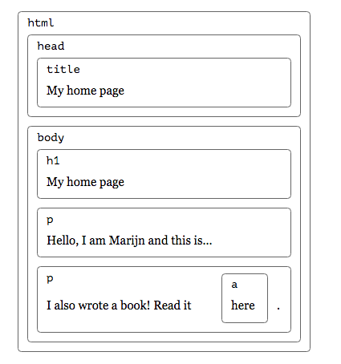
Document structure - example
<!Doctype html>
<html>
<head>
<title>My home page</title> </head>
<body>
<h1>My home page</h1> <p>Hello, I am Marijn and this is my home page.</p>
<p>I also wrote a book! Read it <ahref="http://eloquentjavascript.n et">here</a>.</p>
</body>
</html>

Slide 4
JavaScript – DOM manipulation
One of the most powerful things we can do with JS is access and manipulate the DOM.
JS provides a number of mechanisms for working with the DOM, and there are two principal classes we want to be aware of when working with the DOM:
Node – a generic node in the DOM tree
This includes nodes representing text and other things
Element – a node in the DOM tree specifically representing an HTML element
Element inherits from Node.
There are also several subclasses of Element that represent specialized HTML elements, like links, images, input fields, etc.

Slide 5
DOM manipulation
Right off the bat, the document object has two properties that we can use to jump into the DOM:
document.documentElement – gives access to the <html> element.
document.body – gives access to the <body> element.
Once we have hold of a particular node (like document.body), it gives us several properties that we can use to jump to adjacent nodes in the DOM:
childNodes – an array of all of a Node’s child Nodes
firstChild – a Node’s first child Node
lastChild – a Node’s last child Node
nextSibling – a Node’s next sibling Node
previousSibling – a Node’s previous sibling Node
parentNode – a Node’s parent Node

Slide 6
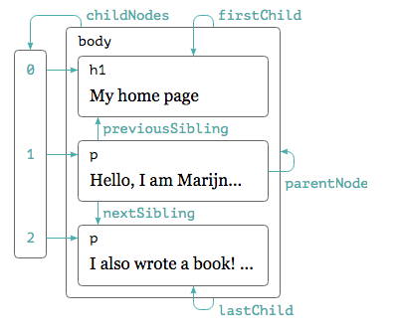
DOM manipulation
DOM nodes contain a wealth of links to other nearby nodes.
The following diagram illustrates these
Each node will have all of these
properties

Slide 7
Easier way to find elements
JS provides us a set of functions that makes it much easier to find specific nodes in the DOM based on different HTML attributes (e.g. class or ID) of those elements. We’ll look at 5 of these functions.
To use all of the functions we’ll explore here, we need some node as a starting point, since each of the functions finds nodes that are descendants of a particular node. Often, we’ll use the document node as the starting point from which to call these functions, since all nodes are descendants of document.

Slide 8
Easier way to find elements
getElementById(): The first function we’ll look at is getElementById(), which allows us to find any single node in the DOM based on the id attribute assigned to it in the HTML.
For example, let’s say we had HTML that contained this element: <button id="my-button">Click me!</button>
We could access that button in the JS like this: var myButton = document.getElementById('my-button');

Slide 9
Easier way to find elements
getElementByClassName: Another important function for accessing arbitrary elements in the DOM is getElementsByClassName(), which allows us to find all nodes in the DOM that have a specified class value.
For example, let’s say we have several images in our HTML, some of which have a given class and some of which do not, something like this: <img class="special-image" src="..." /> <img src="..." /> <img class="special-image" src="..." /> <img src="..." />

Slide 10
Easier way to find elements
In this case, we could access all of the images with the special-image class as follows: var specialImages = document.getElementsByClassName('special-image');
Here, specialImages will be an array-like object that contains all of the images with the special-image class (and not the images who don’t have that class).

Slide 11
Easier way to find elements
getElementsByTagName: A lesser-used but still-important function for grabbing collections of elements is getElementsByTagName(). This function grabs all elements in the HTML that have a certain tag (e.g. <a>, <li>, <img>, etc.).
For example, if we had several images in the HTML as in the example above, we could grab all of them (both with and without the special-image class) as follows: var allImages = document.getElementsByTagName('img');

Slide 12
Easier way to find elements
For example, let’s say we have two lists in our HTML, set up like this:
<ul id="navbar-list"> <li>...</li> <li>...</li> <li>...</li> <li>...</li> </ul> <ul> <li>...</li> <li>...</li> <li>...</li> <li>...</li> </ul>
How can we select only first set of <li> elements?

Slide 13
Easier way to find elements
Sometimes, we need to select elements in such a way that is too complex to represent using a single ID, class, or tag. For these situations, JS provides us with two functions, querySelector() and querySelectorAll(), that allow us to select elements using arbitrary CSS-like selectors.
querySelector() selects the first element matching the specified selector, while querySelectorAll() selects all matching elements.
In this case, we can use querySelectorAll() to give us only the <li> elements that are descendants of the navbar-list: var navbarItems = document.querySelectorAll('#navbar-list li');

Slide 14
Any other way of getting the first set of<li>
var navbarList = document.getElementById('navbar-list'); var navbarItems = navbarList.getElementsByTagName('li');

